Slide 1
Managing Permissions and Services
Cybersecurity
Lesson 4.3

Slide 2

By the end of today’s class, you will be able to:
1
Inspect and set file permissions for sensitive files on the system.
2
Manage and monitor services on the system.
3
Create and assign users for services.

Slide 4

Recap
Linux Access Controls
01
Audit passwords using john
02
Elevate privileges with sudo and su
03
Create and manage users and groups

Slide 5


Access Controls and Permissions

Slide 6
Like Google Docs, Linux has access controls that grant permission
to access documents
and files on a host.

Slide 7
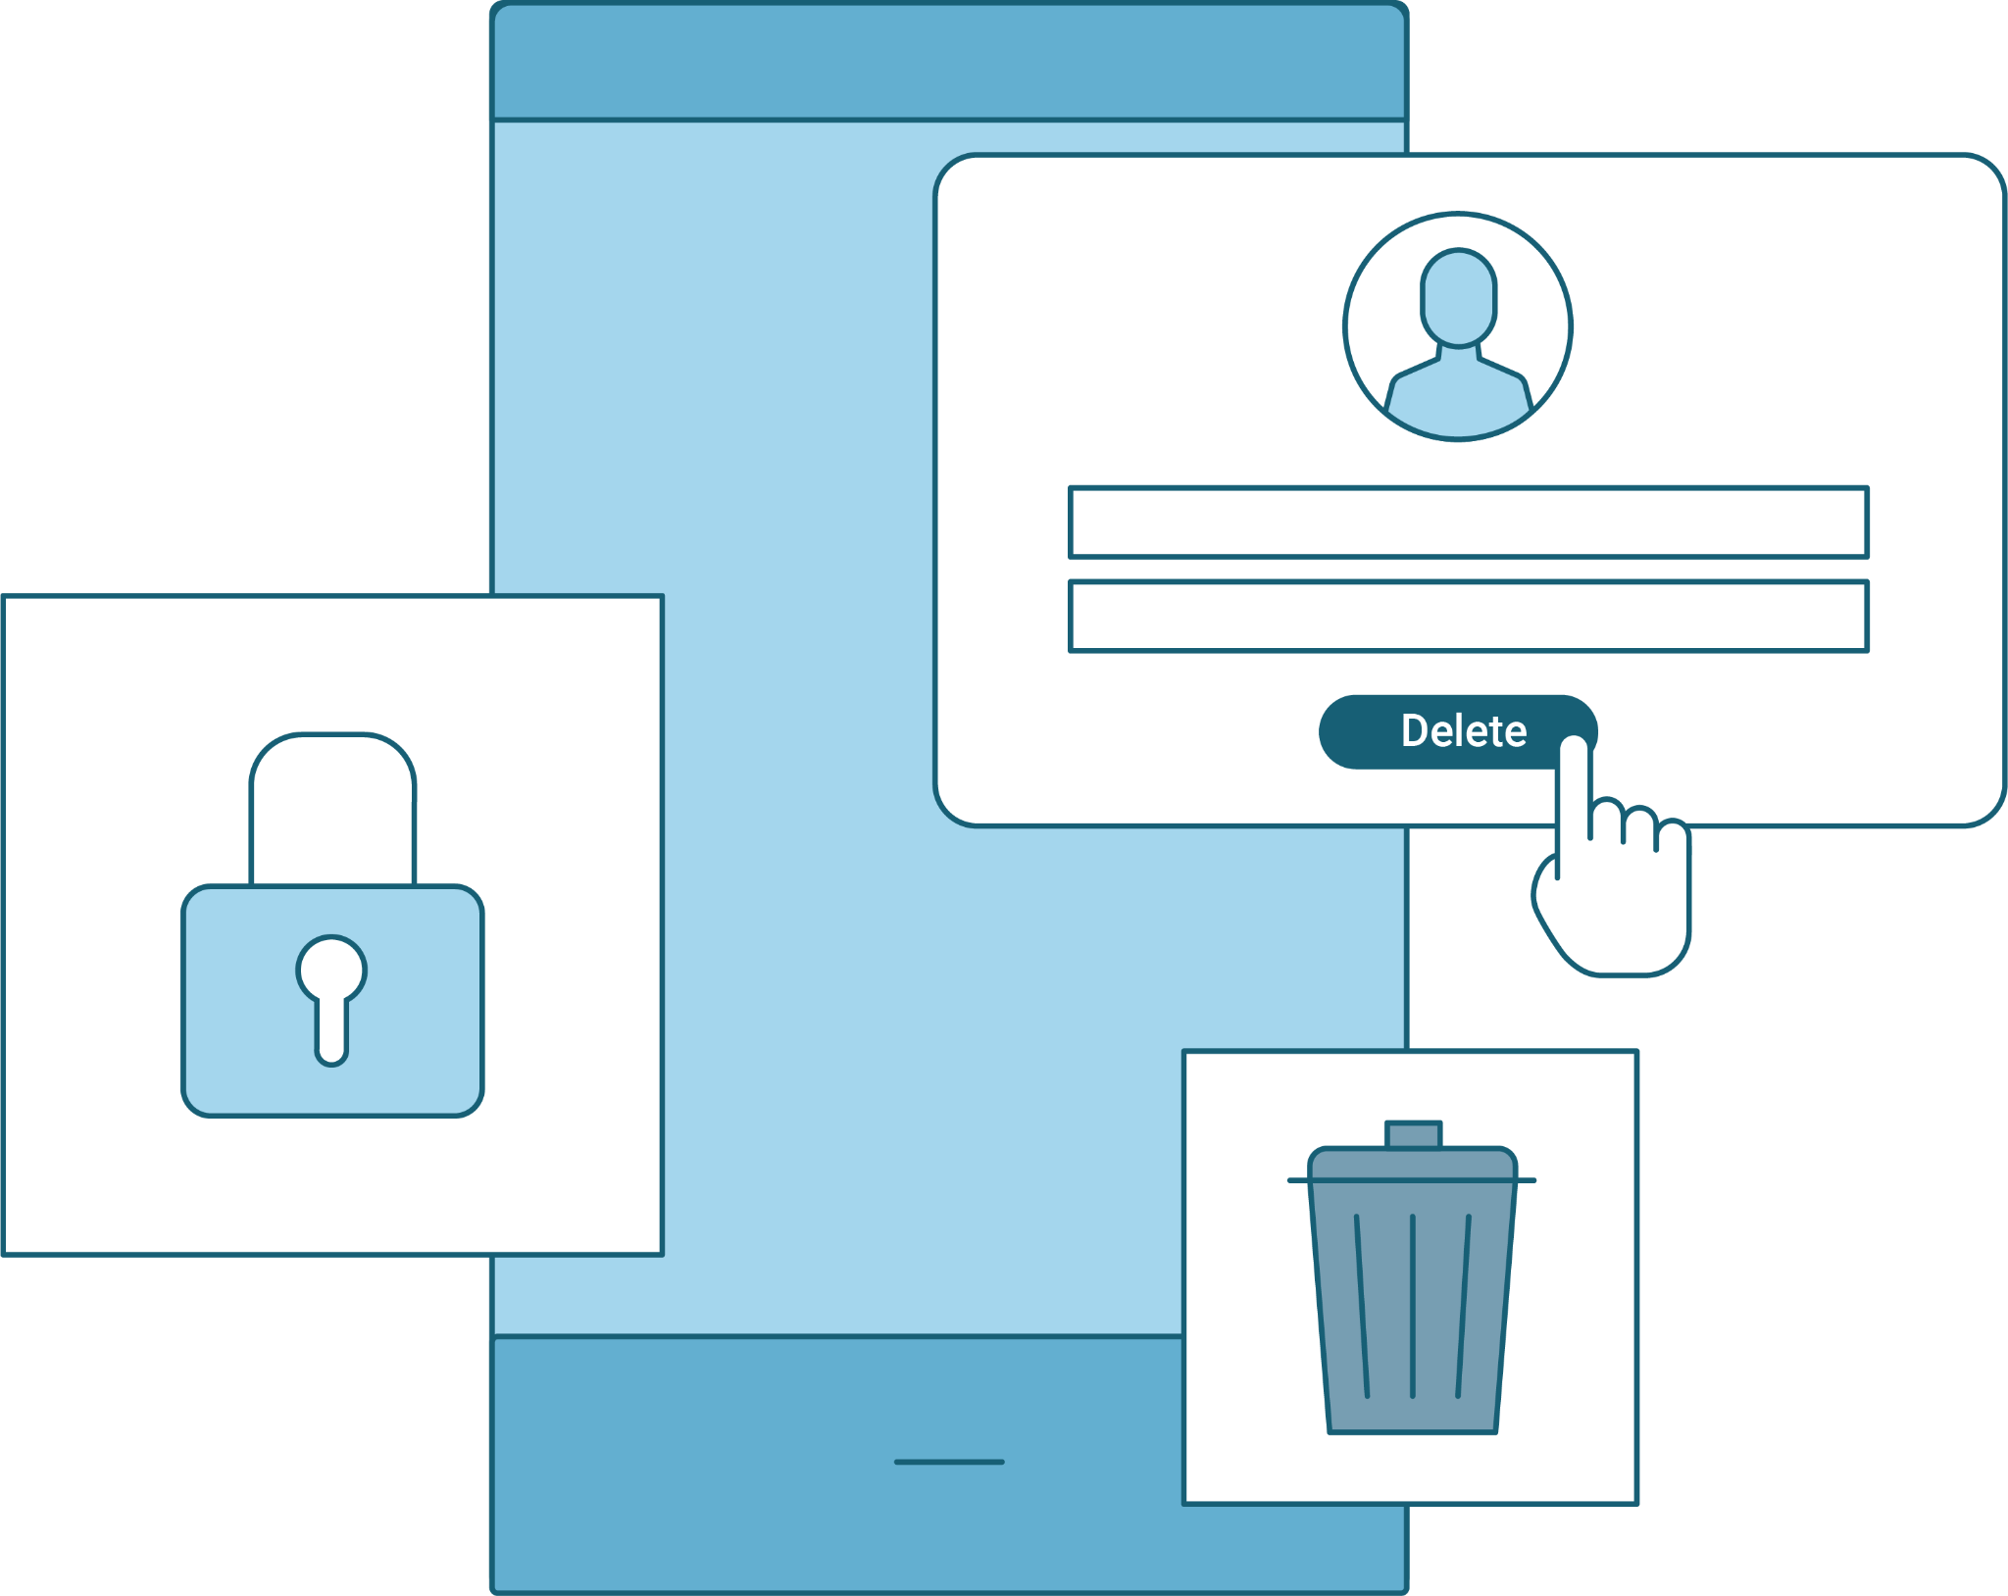
Access Controls and Permissions
Access controls allow actions on a file to include:
Read
Write
Execute
Delete
Rename
Permissions regulate who can take which action.

Slide 8



Managing Access Controls in Linux
Setting Permissions
Linux categorizes files, programs, and directories as items.
Item

Slide 9

Managing Access Controls in Linux
Setting Permissions
Each item specifies access controls for the owner, the group, and others.
Item
rwx

Slide 10
Managing Access Controls in Linux
Setting Permissions
Each item specifies access controls for the owner, the group, and others.
Item
Owner
Group
Other
rwx
rwx
rwx

Slide 11


Access Controls and Permissions
Linux Filesystem Permissions
Owner
Group
Other
User that created the item.
Primary group of the owner.
Everyone who is not the owner or not in the group.

Slide 12
Access Controls and Permissions
Options for Owner, Group, and Other
Read
Write
Execute
Determines if the item can be read or viewed.
Determines if the item can be written to or modified.
Determines if the item can be executed.
r
w
x

Slide 13
With items we can specify if owners, groups, and others are allowed to rwx. This is known as Discretionary Access Control (DAC).

Slide 14


Demonstration Scenario
We will create a file and a directory, and examine the default permissions.
We will also need to change these permissions to deny particular users and groups access.
Commands used:
  ls -l
  chmod
  chown
.
Notes:
shutterstock_1888488028

Slide 15
Permissions

Slide 16
Inspecting File Permissions
-rw-r--r--
Item type (- for file, d for directory)

Slide 17
Inspecting File Permissions
-rw-r--r--
Owner permission (in this case, read and write)
Item type

Slide 18
Inspecting File Permissions
-rw-r--r--
Group permission (read)
Owner permission (in this case, read and write)
Item type

Slide 19
Inspecting File Permissions
-rw-r--r--
Other / world permission (read)
Group permission (read)
Owner permission (in this case, read and write)
Item type

Slide 20







Changing Permissions
Symbolic Notation
Uses letters to set permissions
r
w
x
Octal Notation
Uses base-8 numbers to set permissions
rwx = 7
rw- = 6
r-x = 5

Slide 21
Changing File Permissions
Symbolic and Octal Notation
Octal Notation
 | 4 | 2 | 1
0 | - | - | - | No permission
1 | - | - | x | Only execute
2 | - | w | - | Only write
3 | - | w | x | Write and execute
4 | r | - | - | Only read
5 | r | - | x | Read and execute
6 | r | w | - | Read and write
7 | r | w | x | Read, write, and execute
rwx rw- r--
4 + 2 + 1
4 + 2 + 0
4 + 0 + 0
7
6
4
764
User can read, write, and execute
Group can read and write
Others can read

Slide 22

Demo Summary
Let’s Recap
ls -l
chown user:group
chmod
Symbolic & octal notation

Slide 23
Access Controls and Permissions
In this activity, you will inspect and set file permissions on some of the most sensitive files on the Linux system.
The senior administrator would like you to make sure a few important files and directories are secure by checking and modifying their permissions.
25 Minutes

Slide 27

Managing Services

Slide 28
Servers are just computers that offer services to other computers.

Slide 29

Managing Services
A service is a function or capability that a machine makes available to another.
For example, file-sharing services allow computers to send and receive data.
Notes:
shutterstock_160754045

Slide 30

Managing Services
Some services, like Tripwire, are only run locally on the server and are not provided to other computers. These services are packages that can be installed and removed just like other programs.
tripwire.com

Slide 31


SMB
Server Message Block
Server Message Block (SMB):
File sharing protocol
Windows devices
Open-source version is Samba
Useful, but risky

Slide 32
Demonstration Scenario
The server has already been compromised, and you will proceed by stopping the SMB service, and then uninstalling it from the system.
Steps required:
  List all running services.
  Identify the Samba service in the list to verify that it's running, then stop it.
  Ensure that Samba doesn't start when the machine is started up.
  Ensure that Samba is no longer running.
  Uninstall the Samba service completely.
.
Notes:
shutterstock_1888488028

Slide 33
Finding and Stopping SMB

Slide 34
Managing Services
In this activity, you will continue auditing the services running on this server.
Your senior administrator wants you to audit the services being run on the server and shut down old and unused services. They have provided a list of services to check.
You will check for this list of services and shut down and remove any old service that you find.
25 Minutes

Slide 37
Service Users

Slide 38
Services should be run by a user dedicated to running that service.

Slide 39
Service Users
User ID
A service user usually has a system UID less than 1000 and cannot log in to use a shell.
UID
root:x:0:0:root:/root:/bin/bash
https://www.fosslinux.com

Slide 40

Service Users
Since service users aren’t humans who need to log into and interact with the machine, it’s best practice to ensure that users cannot log into an interactive shell using a service username.
ftp user unable to login to a bash session
Reduces attack surface
Notes:
shutterstock_105536243

Slide 41
Demonstration Scenario
Setup, Removing, and Adding Service
Your senior administrator has asked you to follow up on uninstalling unused services.
You must now ensure the services’ corresponding users have also been removed from the system.
Previously, you disabled vsftpd, but its service user, ftp, still exists.
.
Notes:
shutterstock_1888488028

Slide 42


Demonstration Scenario
Splunk Service Account
Additionally, your senior administrator plans to install Splunk.
They've informed you that they'll handle the installation, but have requested that you create a service user.
.
Notes:
shutterstock_1888488028

Slide 43
Set Up, Removing, and Adding Service Users

Slide 44
Service Users
In this activity, you will continue with auditing the same server for your senior administrator.
The senior administrator would like to remove any old service users from the system and create a new user that will be dedicated to running the Tripwire program.
25 Minutes

Slide 47
Recap
Managing Permissions and Services
01
Set file permissions for sensitive files on the system.
02
Managed and monitored services on the system, removing unused.
03
Assigned users for services.

Slide 48
Create backups and restore data

